Slide 1
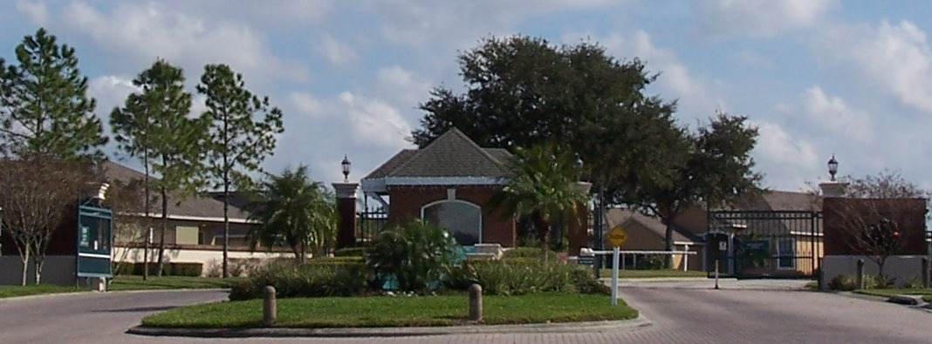
Golden Lakes CDD
Presentation Concerning The Club at Eagle brook

Slide 2
Organizational structure

Slide 3
Management Agreement 2017 Highlights
Minimum fund balance of $30,000 a month;
3 year initial term with ability to renew for (2) additional 3 year terms;
Billy Casper Contract Requirements:
a) Provide required employees to meet the contract scope of services
b) Inventory (procure and maintain) for the operation of the club
c) Supervision of employees
d) Equipment: provide for the Lease/purchase of necessary equipment
e) Purchasing and procurement services
f) Consulting services when and where needed
g) Marketing services
h) Accounting services and vendor payment services
i) Ability to allocate expenditures among line items as long as individual line items do not exceed $20,000 in the aggregate
j) Maintain vendor accounts
k) Administer and manage payroll and benefits for its employees
l) Maintain specified levels of insurance for all operations with the District named as an additional insured on all policies

Slide 4
Management Agreement 2017 Highlights
IT Services provided for all operations
Compensation:
a) Base Management Fee: $7,500 monthly
b) Stop Loss Provision: BCG will set aside an amount equal to three months management fee as a reserve in the event that the Net Operating Income in a Fiscal Year is negative. If in any Fiscal Year the NOI is negative, the District will be credited an amount equal to the net loss up to three months of the management fee.
c) Incentive Pay: BCG will be entitled to earn 10% of the following revenues ( Green fees, cart fees, driving range, pass card sales other golf and membership dues), for all revenues over $1,625,000.
In any case incentive pay will be capped at $25,000 a year

Slide 5
Management Agreement 2017 Highlights
Default/Termination Provisions: There are specific provisions under which the District and BCG may default on the provisions of the contract and cause a default to occur. In this event either party reserves the right to terminate the contract if the default is not cured.
First Amendment to the Management Agreement – 2020
Provisions:
a) Extend the Agreement for (3) years
b) Amendment to the Incentive Pay (from 10% of all revenues over $1,625,000 to 9% with an annual cap of $25,000)

Slide 6
Financial Update

